Slide 1
Supervised learning: Part II

Slide 2
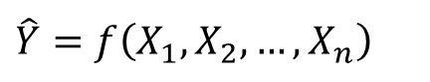
Supervised Learning
X₁ | X₂ | X₃ | … | X_{n-2} | X_{n-1} | X_{n} | Y
x_{1,1} | x_{2,1} | x_{3,1} | … | x_{n-2,1} | x_{n-1,1} | x_{n,1} | y₁
x_{1,2} | x_{2,2} | x_{3,2} | … | x_{n-2,2} | x_{n-1,2} | x_{n,2} | y₂
. . . | . . . | . . . | … … … | . . . | . . . | . . .
x_{1,m-1} | x_{2,m-1} | x_{3,m-1} | … | x_{n-2,m-1} | x_{n-1,m-1} | x_{n,m-1} | y_{m-1}
x_{1,m} | x_{2,m} | x_{3,m} | … | x_{n-2,m} | x_{n-1,m} | x_{n,m} | y_{m}
$$\hat{Y}=f\left(X_{1},X_{2},…,X_{n}\right)$$

Slide 3
Supervised learning
We already saw:
K-NN
Decision trees
Linear regression
In this session, we will meet few more supervised learning algorithms

Slide 4
Agenda
Naïve Bayes
Logistic regression
SVMs
ANNs
Ensemble methods

Slide 5
Agenda
Naïve Bayes
Logistic regression
SVMs
ANNs
Ensemble methods

Slide 6
Naïve Bayes
Example:
Let us consider a training set with 1,000 samples of loans that were requested and granted:
150 loans are defaults while 850 loans were legitimate and returned on time.
Define Y as the outcome of the loan. Y=1 means a default.
With no further information, the best model that we can produce is:
P(Y=1) = 0.15.
Now, let us define X as an indicator on weather or not the loaner owns a house.
 | Legit=0 | Default=1 | Total
Don’t own=0 | 350 | 80 | 430
Own a house=1 | 500 | 70 | 570
Total | 850 | 150 | 1,000

Slide 7
Naïve Bayes
How do we compute P(Y=1|X=1)?
When there is a single explaining variable, we will go to the row that describe it:
If X=0 then P(Y=1) = 80/430 = 0.186
If X=1 then P(Y=1) = 70/570 = 0.123
But what happens if there are many explaining variables?

Slide 8
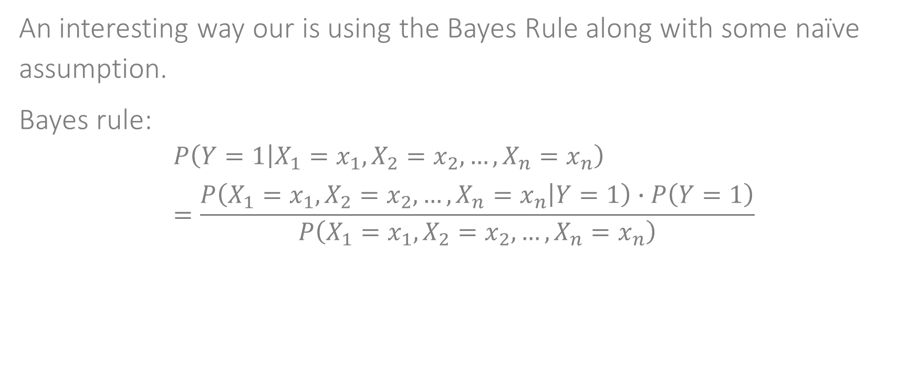
Naïve Bayes
An interesting way our is using the Bayes Rule along with some naïve assumption.
Bayes rule:
$$P\left(Y=1 | X_{1}=x_{1},X_{2}=x_{2},…,X_{n}=x_{n}\right)=\frac{P\left(X_{1}=x_{1},X_{2}=x_{2},…,X_{n}=x_{n} | Y=1\right)∙P\left(Y=1\right)}{P\left(X_{1}=x_{1},X_{2}=x_{2},…,X_{n}=x_{n}\right)}$$

Slide 9
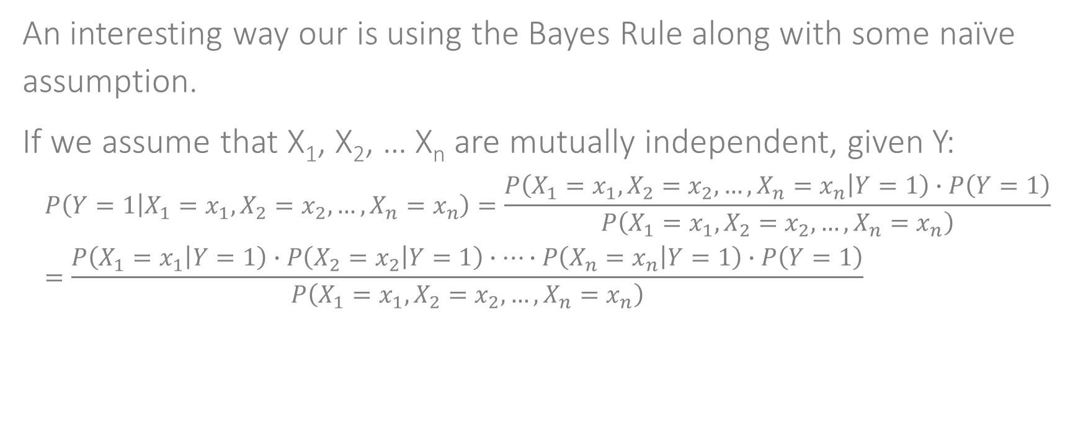
Naïve Bayes
An interesting way our is using the Bayes Rule along with some naïve assumption.
If we assume that X₁, X₂, … X_{n} are mutually independent, given Y:
$$P\left(Y=1 | X_{1}=x_{1},X_{2}=x_{2},…,X_{n}=x_{n}\right)=\frac{P\left(X_{1}=x_{1},X_{2}=x_{2},…,X_{n}=x_{n} | Y=1\right)∙P\left(Y=1\right)}{P\left(X_{1}=x_{1},X_{2}=x_{2},…,X_{n}=x_{n}\right)}=\frac{P\left(X_{1}=x_{1} | Y=1\right)∙P\left(X_{2}=x_{2} | Y=1\right)∙…∙P\left(X_{n}=x_{n} | Y=1\right)∙P\left(Y=1\right)}{P\left(X_{1}=x_{1},X_{2}=x_{2},…,X_{n}=x_{n}\right)}$$

Slide 10
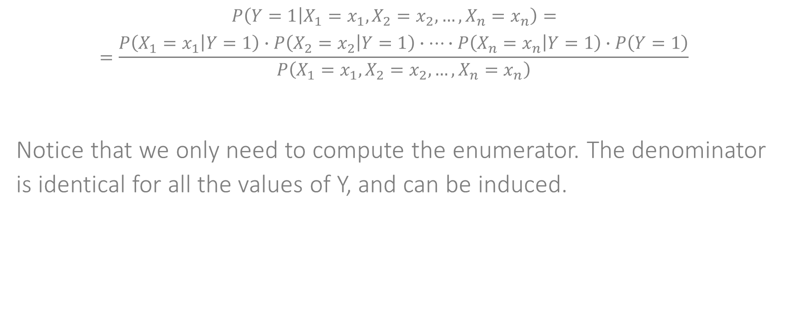
Naïve Bayes
$$P\left(Y=1 | X_{1}=x_{1},X_{2}=x_{2},…,X_{n}=x_{n}\right)=$$
$$=\frac{P\left(X_{1}=x_{1} | Y=1\right)∙P\left(X_{2}=x_{2} | Y=1\right)∙…∙P\left(X_{n}=x_{n} | Y=1\right)∙P\left(Y=1\right)}{P\left(X_{1}=x_{1},X_{2}=x_{2},…,X_{n}=x_{n}\right)}$$
Notice that we only need to compute the enumerator. The denominator is identical for all the values of Y, and can be induced.

Slide 11
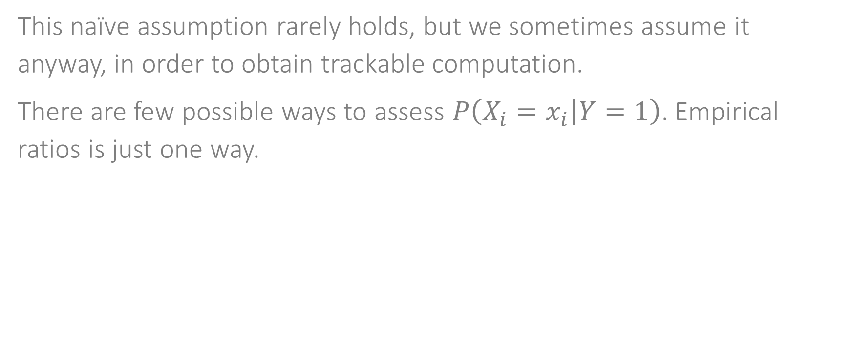
Naïve Bayes
This naïve assumption rarely holds, but we sometimes assume it anyway, in order to obtain trackable computation.
There are few possible ways to assess $P\left(X_{i}=x_{i} | Y=1\right)$. Empirical ratios is just one way.

Slide 12
Bayesian networks
We can reduce some of the naïve assumption, by allowing some dependencies between the explaining features. The result can be represented by a network, called Bayesian network.

Slide 13
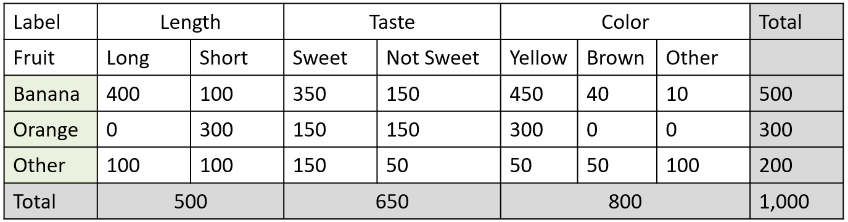
Bayesian networks
Example
Consider a 1,000 fruit training set, and using 3 characteristics we saw that:
Given a new fruit observation of: Long, Sweet and Yellow. Which fruit is it?

Slide 14
Naïve Bayes - summary
The method have two significant advantages:
It is simple and scalable
It can be adapted incrementally
However, the naïve assumption is often invalid, and in some cases this results in inferior performance
Naïve Bayes works well on relative small datasets.
Finally, Bayesian methods sometimes assume discrete features, and if that isn’t the case, some discretization is required.
Naïve Bayes can be used for classification problems but not for regression task.
Works well on high-dimensional datasets.
Great as a quick baseline model.

Slide 15
Agenda
Naïve Bayes
Logistic regression
SVMs
ANNs
Ensemble methods

Slide 16
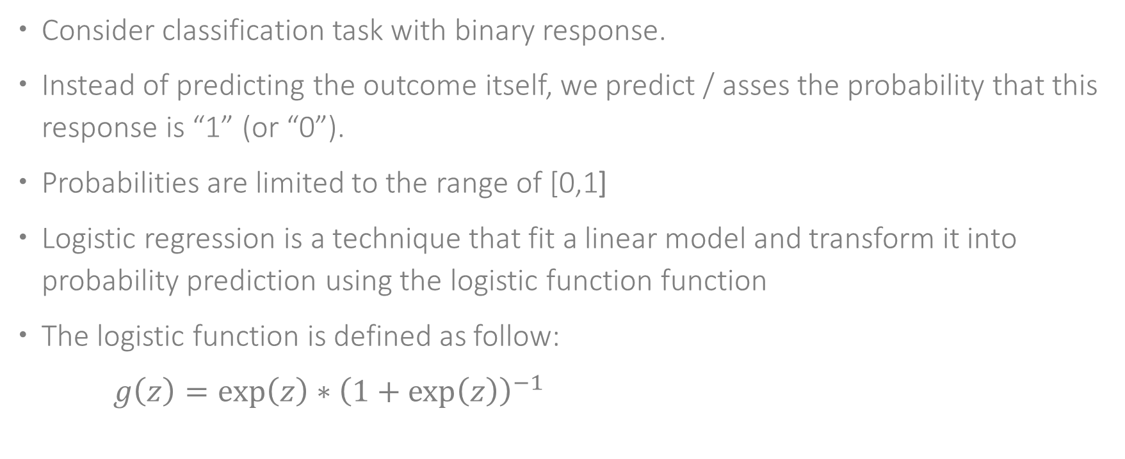
Logistic regression
Consider classification task with binary response.
Instead of predicting the outcome itself, we predict / asses the probability that this response is “1” (or “0”).
Probabilities are limited to the range of [0,1[
Logistic regression is a technique that fit a linear model and transform it into probability prediction using the logistic function function
The logistic function is defined as follow:
$g\left(z\right)={\exp\left(z\right)∗\left(1+\exp\left(z\right)\right)}^{−1}$

Slide 17
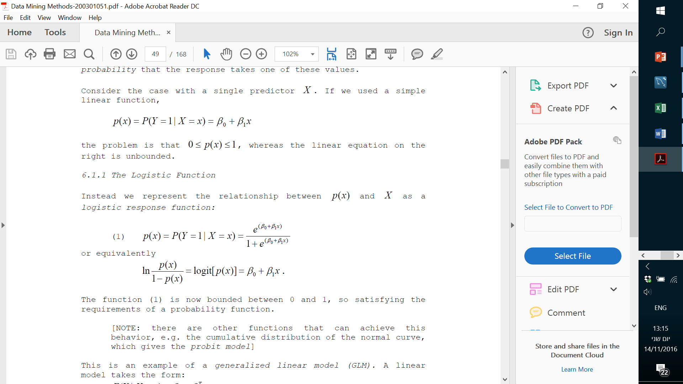
Logistic regression – modeling smooth linear separation

Slide 18
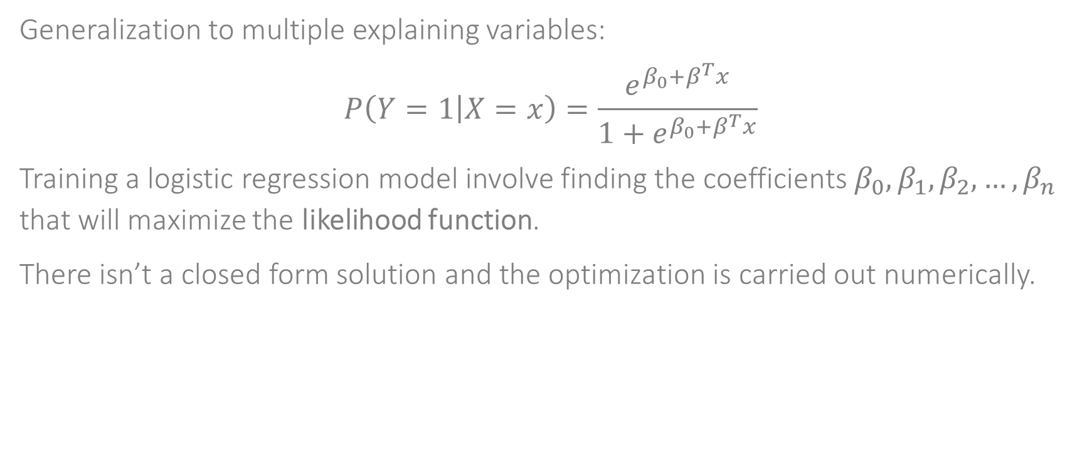
Logistic regression
Generalization to multiple explaining variables:
$$P\left(Y=1 | X=x\right)=\frac{e^{β_{0}+β^{T}x}}{1+e^{β_{0}+β^{T}x}}$$
Training a logistic regression model involve finding the coefficients $β_{0},β_{1},β_{2},…,β_{n}$ that will maximize the likelihood function.
There isn’t a closed form solution and the optimization is carried out numerically.

Slide 19
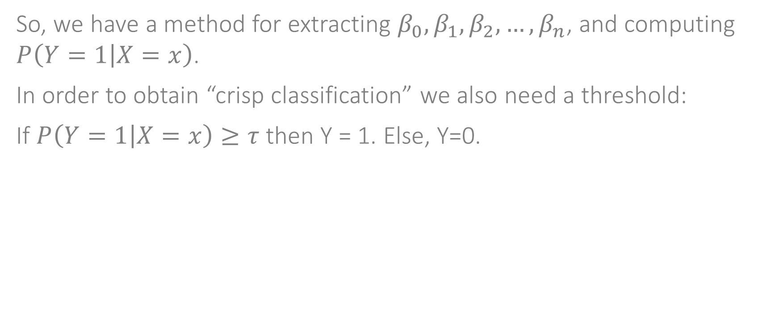
Logistic regression
So, we have a method for extracting $β_{0},β_{1},β_{2},…,β_{n}$, and computing $P\left(Y=1 | X=x\right)$.
In order to obtain “crisp classification” we also need a threshold:
If $P\left(Y=1 | X=x\right)≥τ$ then Y = 1. Else, Y=0.

Slide 20
Optimization in supervised learning
Many supervised learning algorithms are actually optimization methods. We search for the fittest model, that is, from a broad family of possible models, find the one than minimizes some “Loss” between the model and the actual outcome.
In linear regression: Loss = sum of squares.
In logistic regression: Loss (or more appropriate, value function) = likelihood (and we seek for maximization rather than minimization)

Slide 21
Agenda
Naïve Bayes
Logistic regression
SVMs
ANNs
Ensemble methods

Slide 22
SVM
X₂
X₁

Slide 23
SVM
X₂
X₁

Slide 24
SVM
X₂
X₁

Slide 25
SVM
X₂
X₁

Slide 26
SVM
X₂
X₁

Slide 27
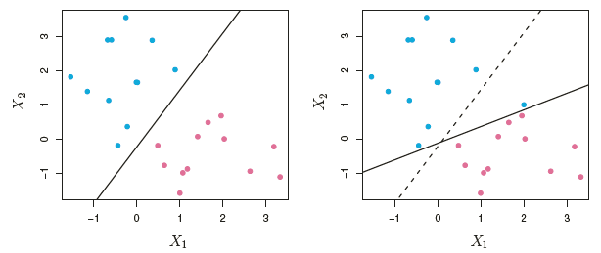
SVM
Hard margins and soft margins:
In most real-world problems, there isn’t a hyper plane that can perfectly separate all the data points.
And even if there is, allowing some points to be in the “wrong” side of the separation might increase robustness.
So, SVMs actually search for a trade off between getting a wide margin vs. penalty on each misclassified point on the training set.

Slide 28
SVM
The Kernel trick:
Our training set might be poorly spreadable assuming linear separation.
But, maybe non-linear separation can work.
The Kernel trick tries projecting the input space into higher dimension, using some transforming function, which is called Kernel.
In the higher dimension, we can then search for linear separation, and then project it on the original space (which has lower dimensionality).
The result is non-linear separation (from some type)

Slide 29
SVM
The Kernel trick:
Example: radial basis function

Slide 30
SVM
The Kernel trick:
Relatively common kernels:
RBF
Polynomial
Sigmoidal

Slide 31
SVM - Summary
General-purpose method with typical strong performance.
Efficient way for projecting into higher dimensions.
Kernel types let us capture many (non linear) structures.
There is no analytic way to find the “right” kernel.
The outcome is not easy to understand (specifically not when using kernels).
All feature should be in numeric representation.
Used for classification (2 class and multi-class).

Slide 32
Agenda
Naïve Bayes
Logistic regression
SVMs
ANNs
Ensemble methods

Slide 33
ANNs
ANNs are networks of multiple artificial neurons, that are affecting each other in various ways, depending on the network’s architecture.
Each node by itself runs a relatively simple computation, and it is the interaction between the neurons that can be designed to model highly complex phenomena.
Inspired from how our brain works.

Slide 34
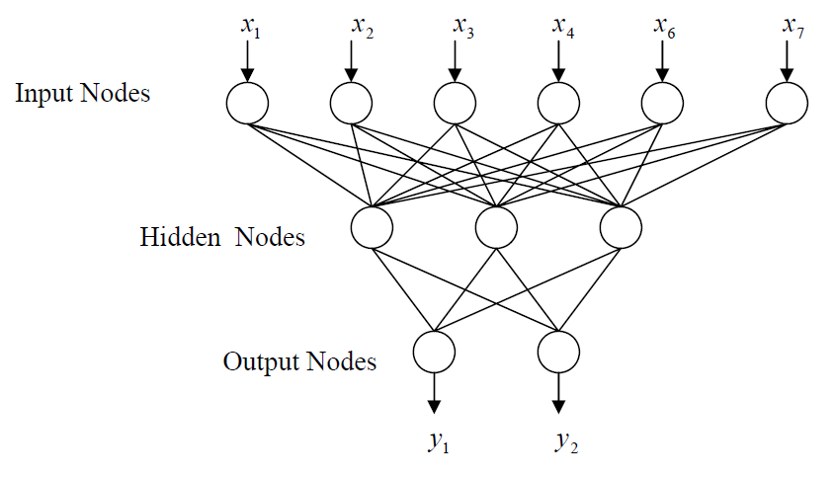
Multi-layered fully connected feed forward ANNS
These are the most common ANNs
They are consisted of:
An input layer with a neuron for each explaining features
At least one hidden layer with at least a single neuron
An output layer that represent the estimation to the output

Slide 35
The typical operation of a neuron
Neurons in the input layer typically simply outputs the value of the input variables that they represent.

Slide 36
The typical operation of a neuron
Hidden neuron:

Slide 37
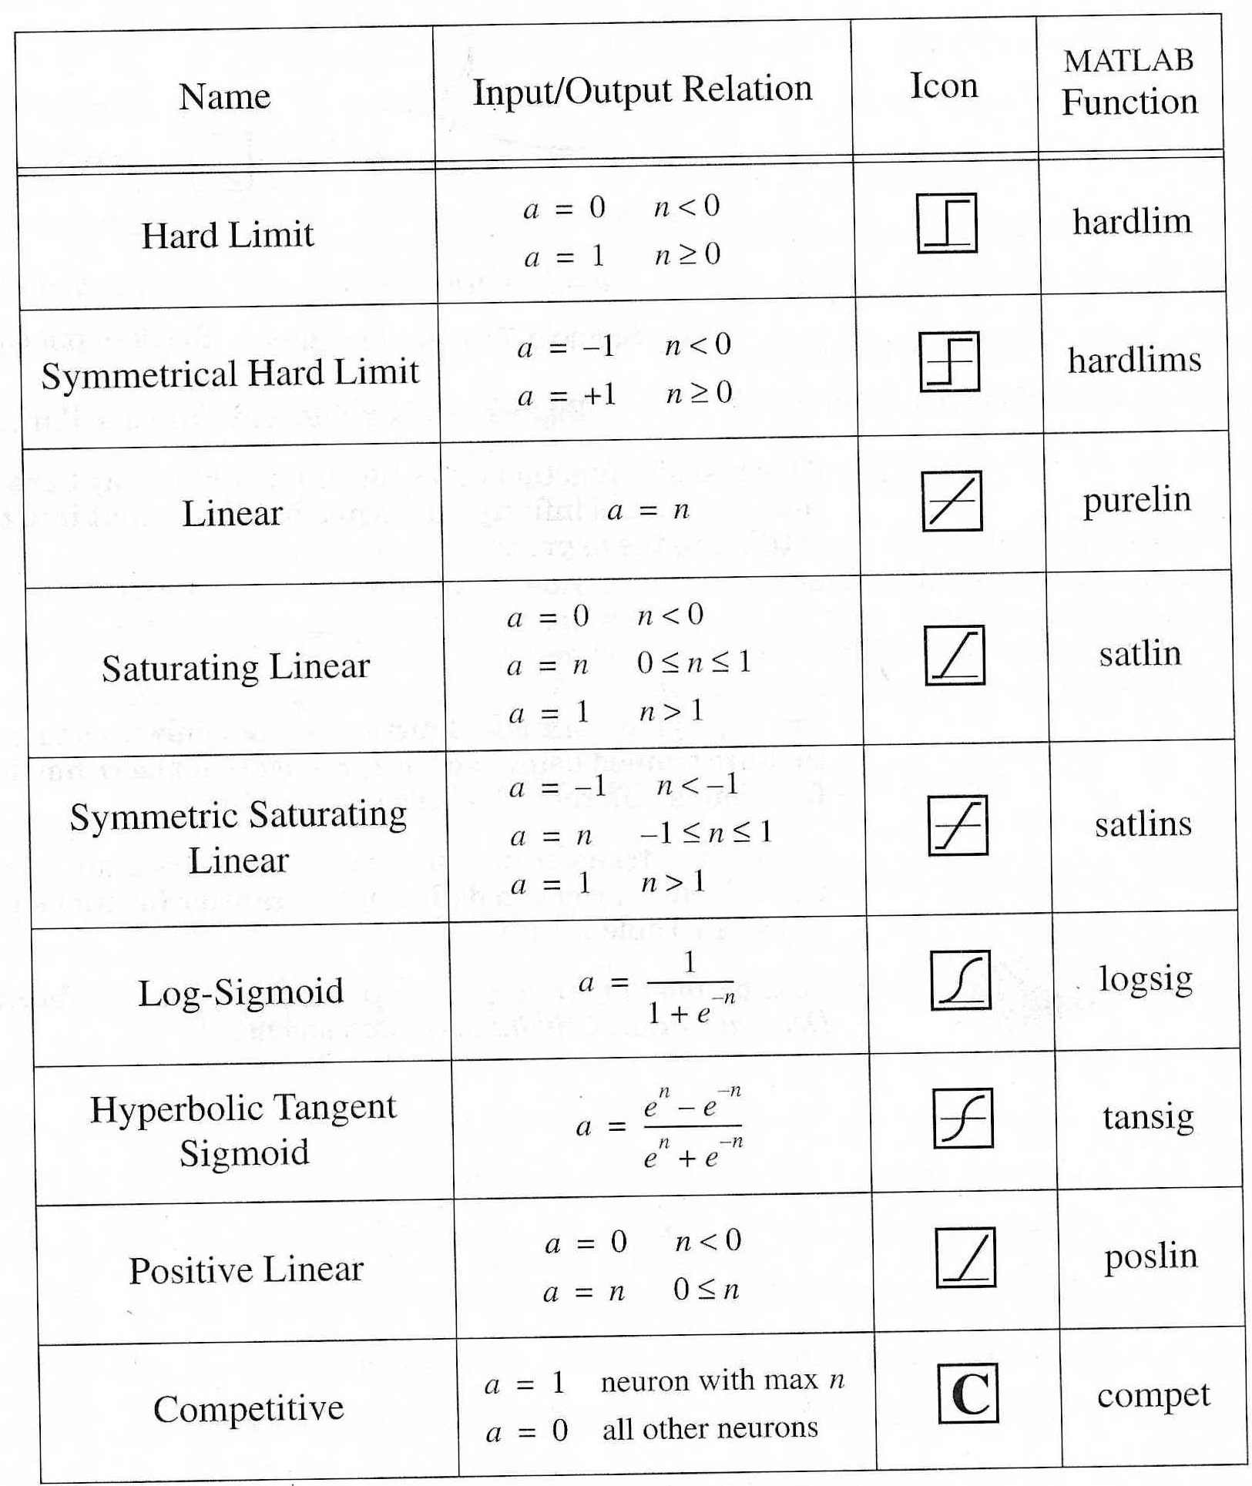
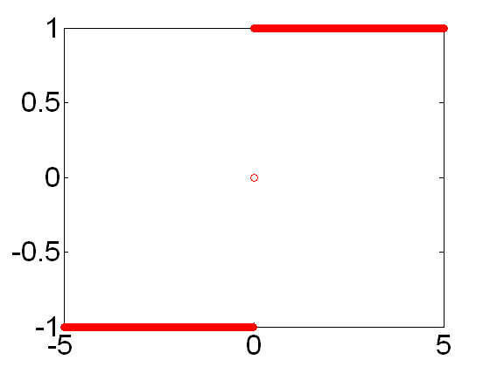
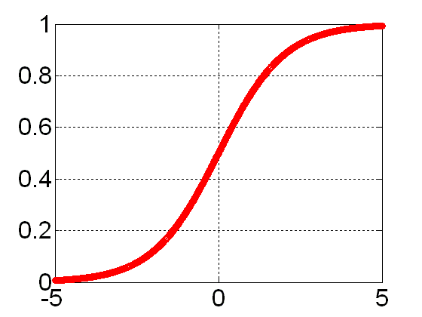
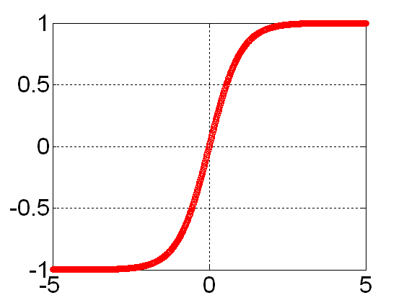
Activation functions

Slide 38
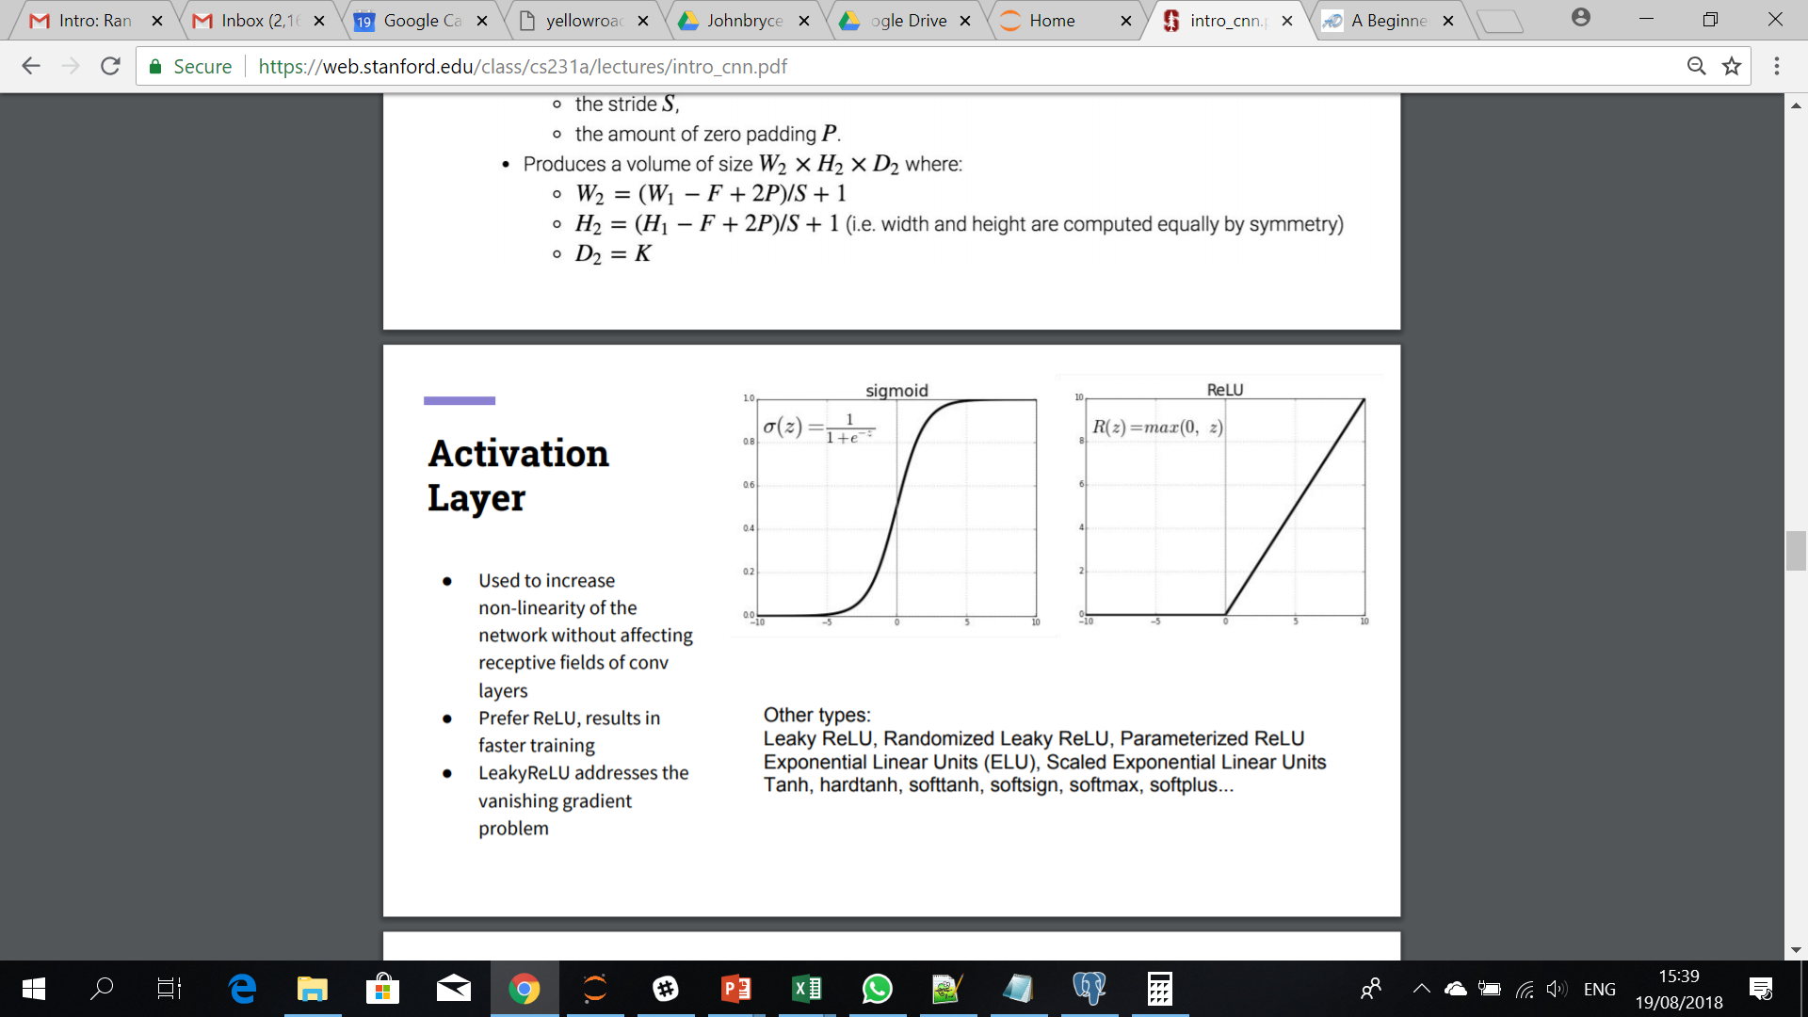
RELU
RELU is an activation function.
In general, activation functions add non-linearity to the network, allowing it to learn more complex concepts
Each convolution (result of applying a filter on a different set of pixels) results in a scalar.
RELU(z) = max{0,z}
RELU is known to achieve faster learning than other activation functions.

Slide 39
The typical operation of a neuron
Output neurons:
In regression: typically a single neuron, representing Y as a linear function of the neurons in the last hidden layer
In classification: typically a neuron for each possible class

Slide 40
How neural networks learn
Neural networks learn by adapting the networks’ weights
How do we do that:
Define a network: Layers, activation function, cost function and optimizer.
Initialize the network weights.
The algorithm compute the error as a function of the set of weights and the cost function.
The optimizer find the gradient.
Reduce the error by changing the
(The algorithm is called backpropagation)

Slide 41
Deep learning
So, what’s new?
More data, from more sources (signals, images, videos, speech, free text,…)
Advanced hardware (mainly GPUs)
Advanced network architectures
As a result: more and more deep learning solutions that solve really hard problems.
The term deep refer to the layers of the network

Slide 42

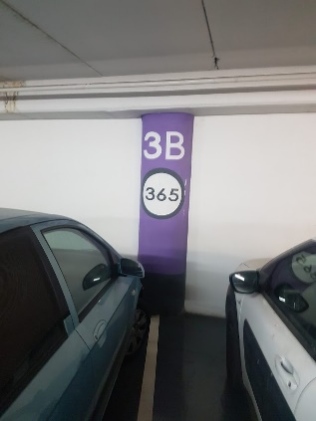


CNNs
CNNs is a class of deep, feed-forward neural networks.
CNNs are mostly applied to analyzing images (in which the vector representation form of images is huge, and the important patterns are relative and not absolute).

Slide 43
Image representation
An image is represented by an array of numbers, which size depends on the resolution.
For example, a JPEG of size 480x480 will be represented by 480*480*3 (691,200) numbers – 480*480 pixels, each with 3 RGB colors.
Such an input space has two main limitations:
It is considerately big, which require a huge set of parameters in order to optimize in a brute force way.
It is discreate, making it hard to generalize from two images that contain the same objects but in a different place in the image.

Slide 44
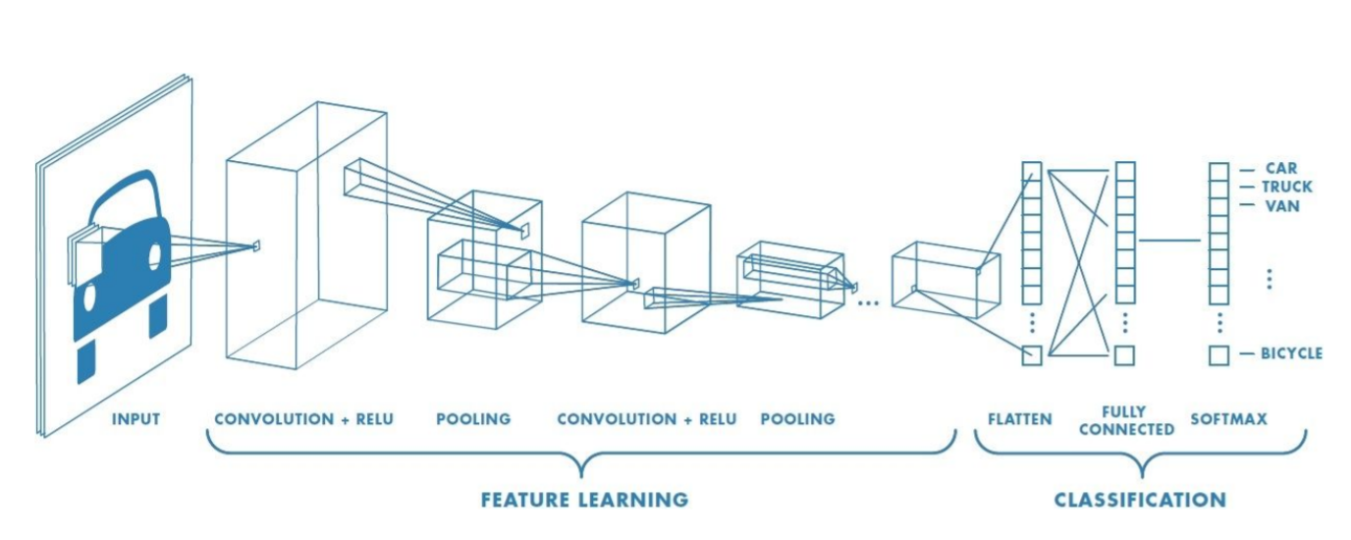
The components of a CNN
Stanford cs231a lecture notes

Slide 45
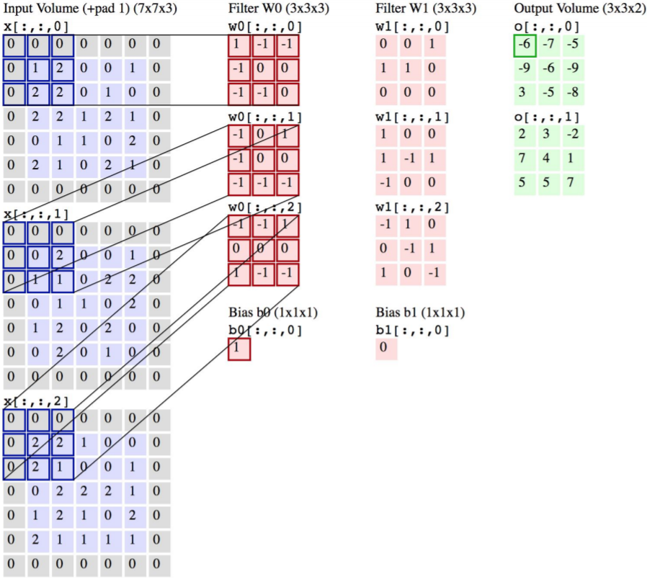
Convolution

Slide 46
Parameters of a CNN
The number of filters (filters are applied in parallel and are shared across all the image)
# of layers
Zero padding
Pooling
The stride
Dropouts
Etc.

Slide 47
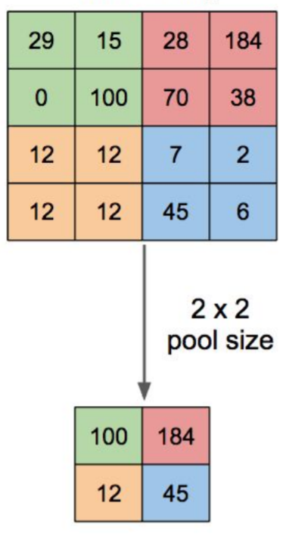
Max pooling
Max pooling applies a non linear aggregation on the outputs of the convolutions + RELU
An aggressive operation, which is sometimes skipped

Slide 48
Dropouts
Dropouts form a one way to avoid overfitting:
During the training, randomly ignore activations (don’t ignore them in testing)

Slide 49
CNNs and abstraction

Slide 50
RNNs
Recurrent Neural Networks (RNNs) are networks that process input data sequentially.
Each unit in the network takes as input the output of the previous unit, as well as a new input element.

Slide 51
RNNs and language models
A Language model is central in many NLP solutions.
A Language Modeling, is a probabilistic model that can predict the next word in the sequence given the words that precede it.
Language models are useful for both understanding language and generating language.
RNNs provide a very strong way to model language.

Slide 52
ANN-based auto encoders

Slide 53
To deep or not to deep
Condition: we have enough data!
When to use it:
Incoming data is very “raw” and we do not know how to represent it semantically.
We will let the network build the sematic by itself.
Usage scenarios: Image, Video, High frequent time series signals.
When not to use it:
We have domain knowledge and ability to express it in our dataset.
A relatively simple patterns solve the task good enough.

Slide 54
ANNs summary
ANNs are very flexible and powerful for solving complex SL tasks.
Yet, ANNs are hard to train, both conceptually and computationally.
Due to their high flexibility, ANNs are also highly prune to overfitting.
Deep learning is just “re branding” of ANN.
Deep learning in most cases is not the right solution.
When developing ANN, you invest time in shaping the right neural architecture, and let the raw features to extract the information automatically in the hidden layers.
In the past ANN’s were computationally blocked.
Mainly due to the use of GPU’s, they became feasible.

Slide 55
Agenda
Naïve Bayes
Logistic regression
SVMs
ANNs
Ensemble methods

Slide 56
The wisdom of the crowds
Under certain controlled conditions, the intelligence of the crowds is higher that this of a single human expert.
Imitates our second nature to seek several opinions before making any crucial decision.

Slide 57
Ensemble methods
The term “ensemble methods” refer to solutions in which a single supervised learning task is solved by multiple supervised learning models.
There are many ways to combine multiple models.
Actually, many “advanced” solution are actually some sort of ensemble.
In addition to local tailored ensembles, there are few systematic ensemble methods.

Slide 58
Ready made ensemble methods
Bagging
Random Forest
Boosting
AdaBoost
Gradient boosting

Slide 59
Bagging
Use a single, baseline supervised learning algorithm.
Instead of applying it just once, apply it n times, over n samples from the training set.
Let each sample be in size of the entire training set (sample with replacement)
Combine the n models into a single prediction

Slide 60
Bagging
Use a single, baseline supervised learning algorithm.
Instead of applying it just once, apply it n times, over n samples from the training set.
Let each sample be in size of the entire training set (sample with replacement)
Combine the n models into a single prediction

Slide 61
Random forest
Random forests are specific implementation of ensemble of classifiers.
The basis classifier is decision tree.
We build multiple decision trees.
In each tree, and each node, the split is selected from a random selection of input features m, where m << |all features|.
Random forests are both powerful and fast (thanks to the random selection).
To classify a new record, collect votes from every tree in the forest and then use majority voting.

Slide 62
Random forest
It is one of the best performing algorithms available. For many data sets, it produces a highly accurate classifiers.
It runs efficiently on large databases.
It can handle thousands of input variables without variable deletion.
It gives estimates of what variables are important in the classification.
Not easy to interpret.

Slide 63
Boosting

Slide 64
Boosting

Slide 65
Adaboost
Adaboost is a specific implementation of the boosting idea

Slide 66
Gradient boosting
Gradient boosting assumes a weak model for predicting Y.
It is then looks at the loss function, and searches for another weak model to reduce the loss (in many cases to explain the residuals of the first model), and so on.
Gradient boosting is often implemented with decision trees as the baseline algorithm.
A favorable by many data scientist:
Tend to have good performance
It is very efficient (compute wise).
Similar to Random Forest it’s output include feature importance.

Slide 67
Custom ensembles
The amount of options is endless.
A very good practice.
You should understand your models performance well in order to build appropriate ensemble.
Remember the key principles for having a good “crowd” (group).
You must use a set of “weak” learners, do not try to optimize too much.
How can you identify a good potential group of classifiers?

Slide 68
Few more things on Supervised Learning

Slide 69
Multi class problem
Some algorithms (decision-tree based, Bayesian) naturally support multi-class problems, where others (logistic regression, SVM) do not.
The generic way around is typically one versus all.
One versus all is a good practice mainly when there are really many possible class labels.

Slide 70
Unbalanced training sets
Quite common. What can we do:
First, choose the correct evaluation metric
Prefer Precision-Recall graph instead of ROC graph
Down sample the big class
Up sample the small class
Create synthetic data (SMOTE algorithm)
Change the cost metrics

Slide 71
Regularization
Regularization refers to a set of methods that discourage highly parameterized models
Cost function = Loss (say, binary cross entropy) + Regularization term

Slide 72
Supervised learning - summary
“For any two learning algorithms, there are just as many situations (appropriately weighted) in which algorithm one is superior to algorithm two as vice versa, according to any of the measures of "superiority"“

Slide 73
Supervised learning - summary
Modeling is an iterative work.
The first step is have a well defined evaluation mechanism.
Then you should always have a simple model \ business rule performance results as benchmark for future efforts.
In each modeling iteration you can try and improve your previous results by:
Custom ensembles
Feature engineering
Optimizing algorithm hyper-parameters makes incremental improvements.
Bringing new data sources, changing your algorithmic approach, engineer new features \ knowledge lead to breakthroughs.

Slide 74
Supervised learning - summary
Although modeling phase is the sexiest phase, it’s actually quite technical.
You can practice it by yourself:
Use Kaggle, or find open datasets (e.g. UCI repository)
The real magic is in seeing a business case and translating it into a ML task

Slide 75
Supervised learning: Part II

